Slide 1
Early Insights - Team C
Eric Gaudreau, Raghu Nema, Mariano Amaya, Sam Dvorin, Shangyuan Chen

Slide 2
Project Summary
The city of Boston is interested in a report regarding the nature of animal complaints on the city’s 311 app. This includes the number of complaints, kinds of animals, distinct geographic areas where animal complaints are common, and trends in said complaints (such as season, or weather).

Slide 3
Key Questions We Tackled
Data Source
How many reports were there in the previous 2-3 years? 5-10 years? Are there any positive or negative trends to these reports (decreasing in sum total, etc)?
How do other factors such as season impact the nature of the complaints? (ie: are there more complaints in the summer? Winter?)
Analyze Boston Yearly 311 Service Requests in CSV file format (Years 2011 - 2023)
Used Python File to Parse all Requests Relating to Animals
Link: https://data.boston.gov/dataset/311-service-requests

Slide 4
General Trends

Slide 5
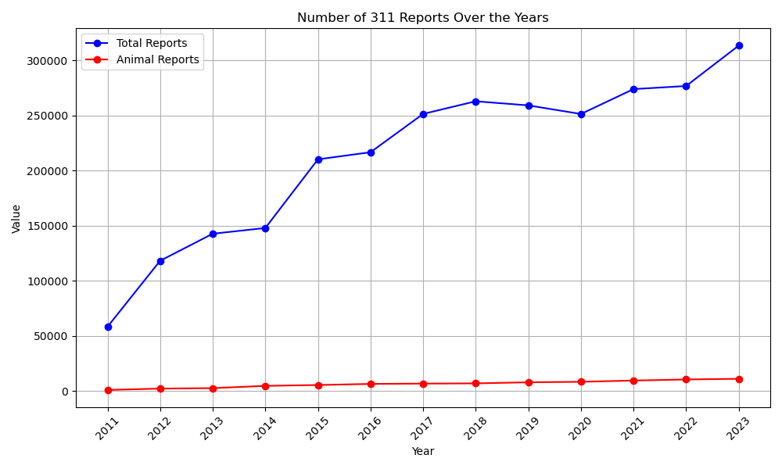
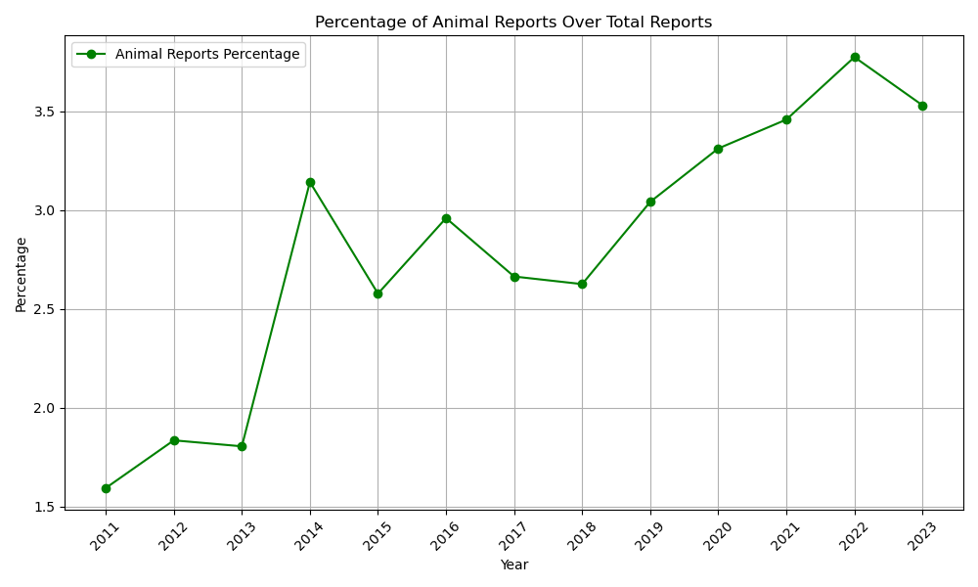
TRENDS:
Steady increase over the years
Growing proportion of animal related issues within the total number of reports submitted to the city’s 311 system, especially notable in recent years.
ANALYSIS: The steady increase in total reports could be due to several factors
Growth in the population leading to more incidents being reported
Increased awareness or ease of reporting through the 311 system

Slide 6
Animal Specific

Slide 7
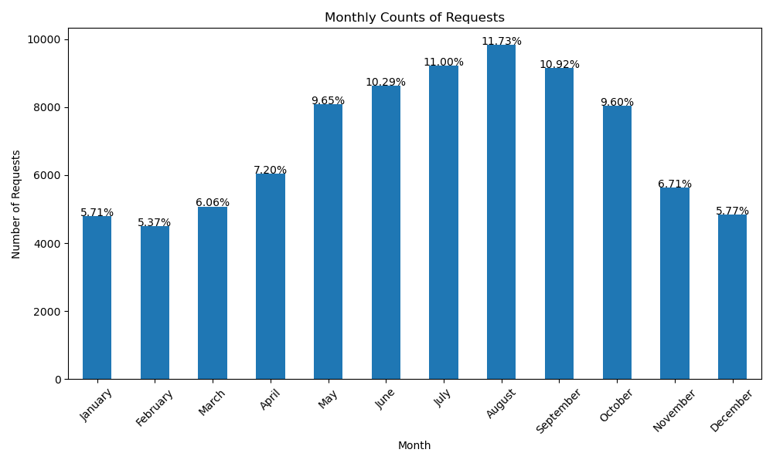
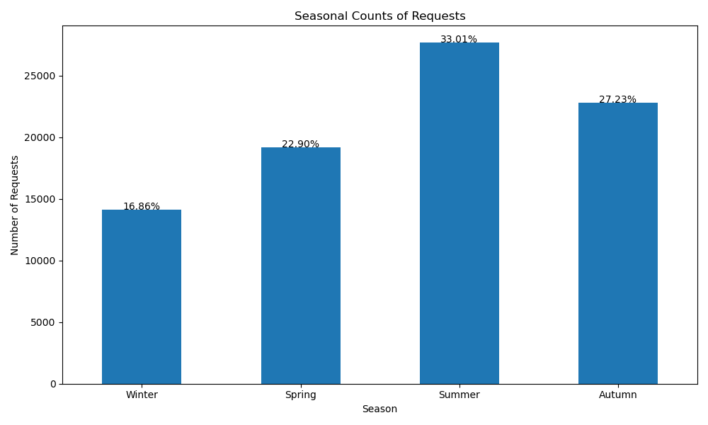
ANALYSIS:
Increased human outdoor activity, longer days, warmer weather may lead to more sightings
Animals may exhibit heightened activity levels during the summer, such as breeding or foraging behaviors, causing encounters with humans.
TRENDS:
There is a peak in the amount of animal reports during the summer months

Slide 8
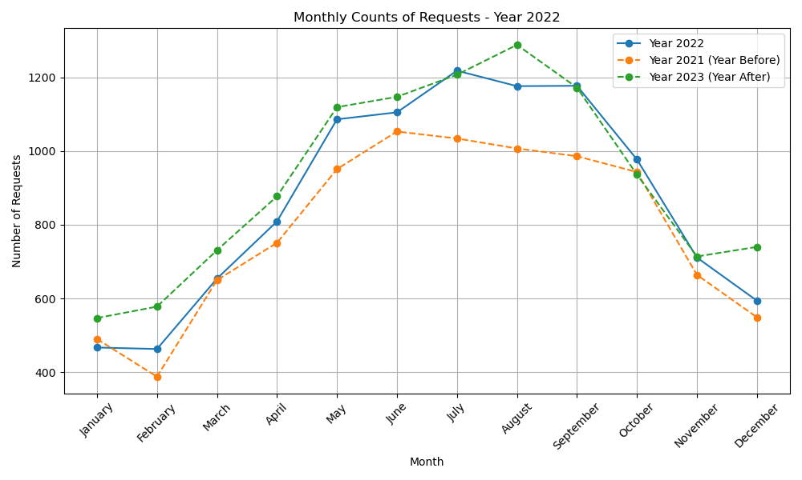
TRENDS:
Warmer months typically have an increase in complaints.
Significant decrease from July to December could be due to colder weather, which could lead to a reduction in animal activity and consequently fewer complaints.
An increase in the request counts from the 2023 data compared to 2022, which could suggest an increase in public awareness campaigns.
ANALYSIS:
It would be beneficial to examine any concurrent events such as like new city initiatives, or demographic changes.
Correlating the data with weather patterns, geographic information, or city events could provide more insights into the causes of the trends.

Slide 9
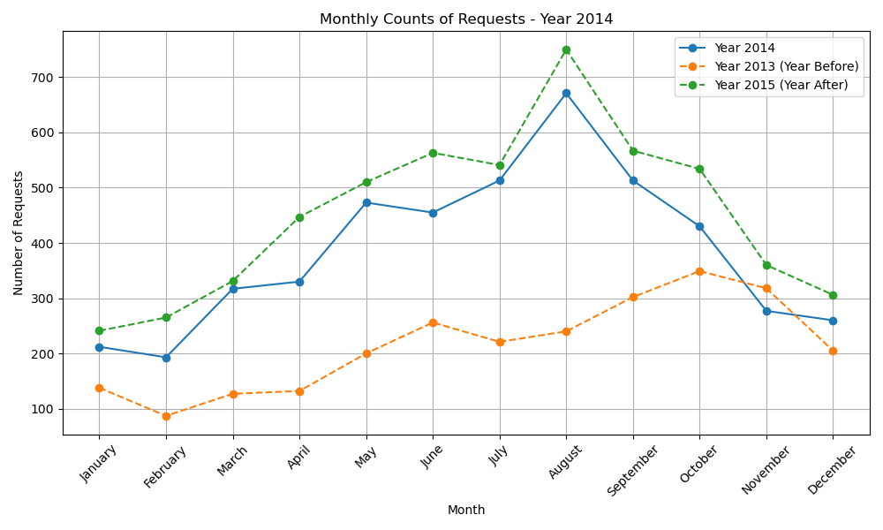

Slide 10
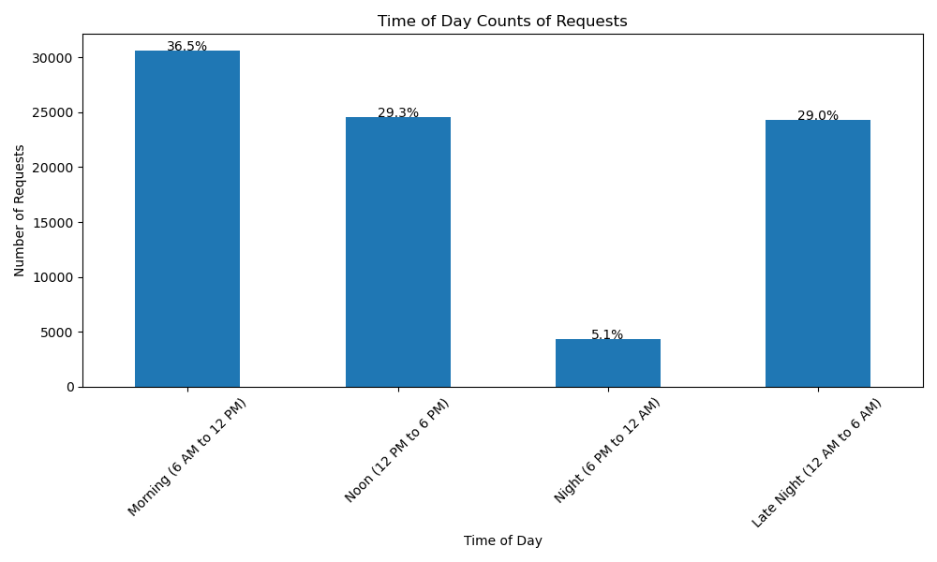
TRENDS:
Most reports are received in the morning, but there is also a high peak for late evening
The number of reports is extremely low during Night time
ANALYSIS:
When people wake up in the morning they report anything that has occurred overnight
Late night reports could be due to nocturnal animals, specifically rats.
Most people are sleeping during the night, which would account for the low report number

Slide 11
Limitations of Data
Are there places where we are missing complaints or we don't have sufficient documentation?
Biased Reporting due to language barrier or unknown service in the area (students)
Oftentimes if there are requests that are closed because there is not enough information to process it so they have not been completed but are marked as “complete”.
The data we are analyzing is from “Analyze Boston” (2011-2024), so 2010 data from “Harvard Data” is set up differently and hard to work into our data models

Slide 12
Next Key Questions
Potential Questions We Came Up With
Where are the complaints coming from geographically? Is there any trend to type of animal complaint and area?
Grouped by “LOCATION_ZIPCODE” column or “neighborhood_services_district” column
What kinds of animals are most common in complaints? (Rats? Domesticated pets? Dogs? Cats?)
Parse each row similar to how we did to find all animal reports for specific animals (ie Dog, Cat)
How many requests were never closed? Is it related to season or zip code?
If a request gets closed, how many are late at the time of their closing per year?
sla_target_dt: > closed_dt:
Notes:
Are the potential questions worth pursuing. Do you want us to see something like this?

